Slide 1
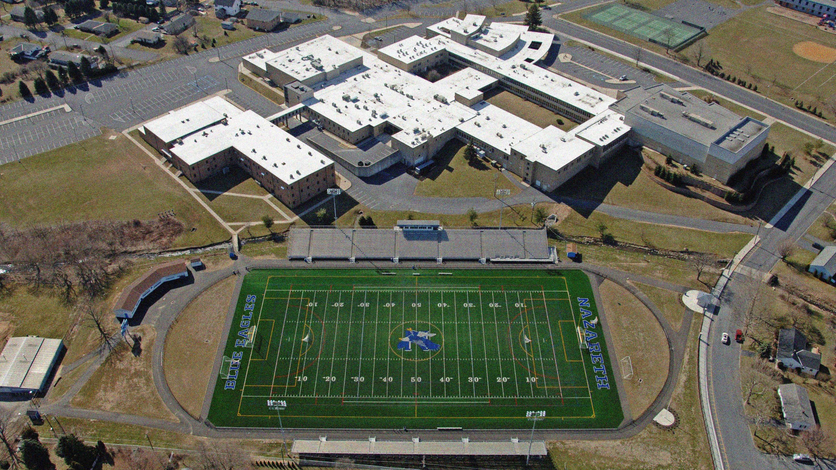
Nazareth Area School District
Enrollment Projection Study Update
Planning for the Future
August 13, 2024

Slide 2
Integration Team
School Board Representation
Dr. Linda Stubits
Mr. Gregory Leh
Mr. Wayne Simpson
School District Administration
Dr. Richard Kaskey
Dr. Isabel Resende
Dr. Stuart Whiteleather
Mr. Robert Zemanick
Ms. Dana Hoffman
D’Huy Engineering, Inc.
Mr. Arif Fazil, P.E.
Mr. Christopher Haller

Slide 3
Purpose of the Presentation
The Integration Team of Board Representatives, District Administration, and D’Huy Engineering has gathered data for discussion and direction by the Board.
The purpose of this presentation tonight is to provide the Board and the Community with the first step of a multi-tiered process that addresses the enrollment and facilities across the entire district. Tonight’s presentation will focus on the needs and enrollment at the elementary schools (Phase 1).
This committee will provide information on the enrollment and needs of the secondary schools at a future time (Phase 2).

Slide 4
Agenda
Educational Specification
Elementary School Program of Scheduled Area
Residential Development Research Report by PowerSchool
Elementary School Enrollment
Elementary School Options for Consideration
Municipal Parcels
Summary
Next Steps

Slide 5
Educational Specification
The Mission of the Nazareth Area School District, a catalyst for excellence in education, is to develop students through rigorous educational and co-curricular programs into critical, reflective thinkers with the knowledge and skills to communicate effectively, to integrate technology for learning, and to contribute to an ever-changing, diverse community.
Educational Value Statements
Students
Right to a free and public education, voice their opinions, and participate in the educational community.
Staff
Develop all students to their fullest potential; education is a shared responsibility; provided with a safe and secure environment.
Administration
Provide a high-quality curriculum and instruction in a safe, supportive and effective learning environment; students meet their post-secondary goals; education is a shared responsibility.
Parents
Acknowledge the importance of their involvement in supporting their students in their educational journey.
Community
Students have a right to a free and public education that supports them in achieving their post-secondary goals and developing into productive citizens within our community.

Slide 6
Educational Specification
Purpose of Functional Capacity Analysis:
Physical Condition of the buildings to provide a safe and secure learning environment.
Functional Suitability of the buildings
How well the building layout, space allocation, and amenities accommodate the educational activities it was designed to meet.
Impact of enrollment growth on the school’s ability to deliver the existing programs over the next 10 years:
Goal is to maintain Elementary School Enrollment between 500 and 650 students per building.
By 2033, all three elementary schools are expected to be above their planned capacity.
As building capacities are reached, it may further impact the delivery of the existing programs or the ability to expand programs.

Slide 7
Educational Specification
Nazareth Area School District Educational Design
Purpose
Prioritize the well-being of the whole child
Embrace future-ready skills
Integrate technology
Foster critical thinking, collaboration, creativity, and communication
Embrace STEAM education
Empower students to meet their post-secondary goals
Physical Design Priorities K-12
Classrooms adaptable to different learning styles
Collaborative small group spaces for students and staff
Communication and Connectivity with classrooms
Storage Solutions
Areas to showcase student achievements
Prioritizing confidential spaces, safety and security
Multifunctional Cafeterias
Multifaceted Library Media Centers
Robust Technology Resources and Infrastructure
Multifaceted spaces for physical and mental well-being of students and staff
Optimizing artistic and athletic performance venues

Slide 8
Educational Specification
NASD Educational Design for K-6
Purpose
Emphasize a student-centered approach with dedicated spaces and resources to foster a well-rounded educational experience
Core Programming Elements
Grouping for supportive learning environment
Classrooms grouped by grade level and/or subject areas
Proximity of general education classrooms to special education and related services classrooms and small group rooms
Dedicated spaces for staff, students, and their collaboration
Labs (unspecified), STEAM Labs, Design Labs
Immersive Learning Centers
Library Media Centers, Gyms, Auditorium/Performing Arts/TV Studios
Calming/Sensory Rooms
Additional Programming Elements
Small class sizes
Inclusive Playgrounds
Small group rooms for support services
Multipurpose outdoor spaces for learning

Slide 9
Elementary School Program of Scheduled Area
Functional Capacity of Existing Schools
The functional capacity of a school is the number of students that a school can accommodate based on the needs of the school in compliance with their practice and Educational Specifications.
The capacity is calculated based on the number of available Classrooms and Kindergarten Rooms.
Capacity is calculated based on the number of students per room as follows:
Kindergarten through 2nd Grades – 20 Students
3rd and 4th Grades – 23 students
Special Education, Common Core, & Support spaces such as the arts (Art, Music, STEAM, etc.) are not included in the calculation of the Functional Capacity.
Temporary Capacity for Curricular Needs
There are existing spaces within each school that are currently utilized for other program needs.
These spaces may be utilized for increased enrollment on a temporary basis.
Other programs may be impacted when utilizing these spaces.

Slide 10
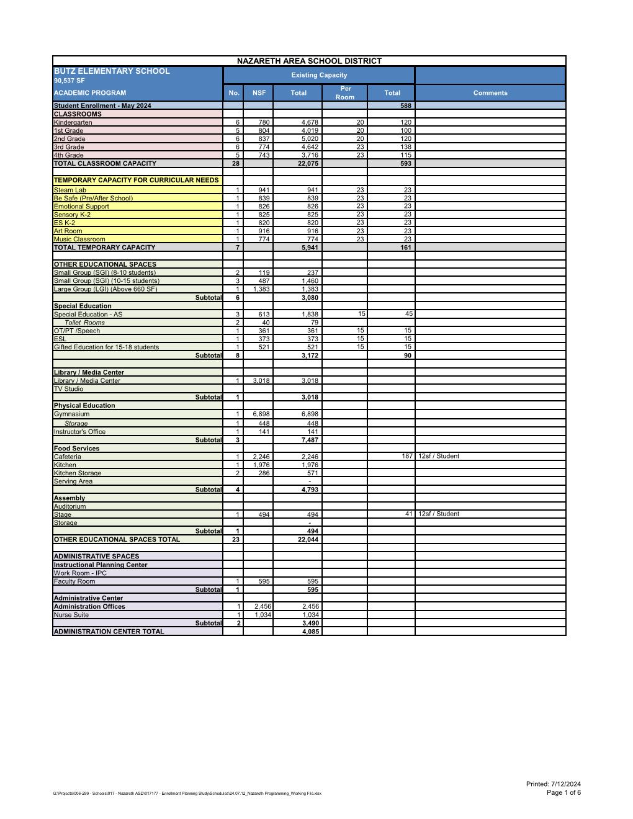
Elementary School Program – Kenneth N. Butz Jr.

Slide 11
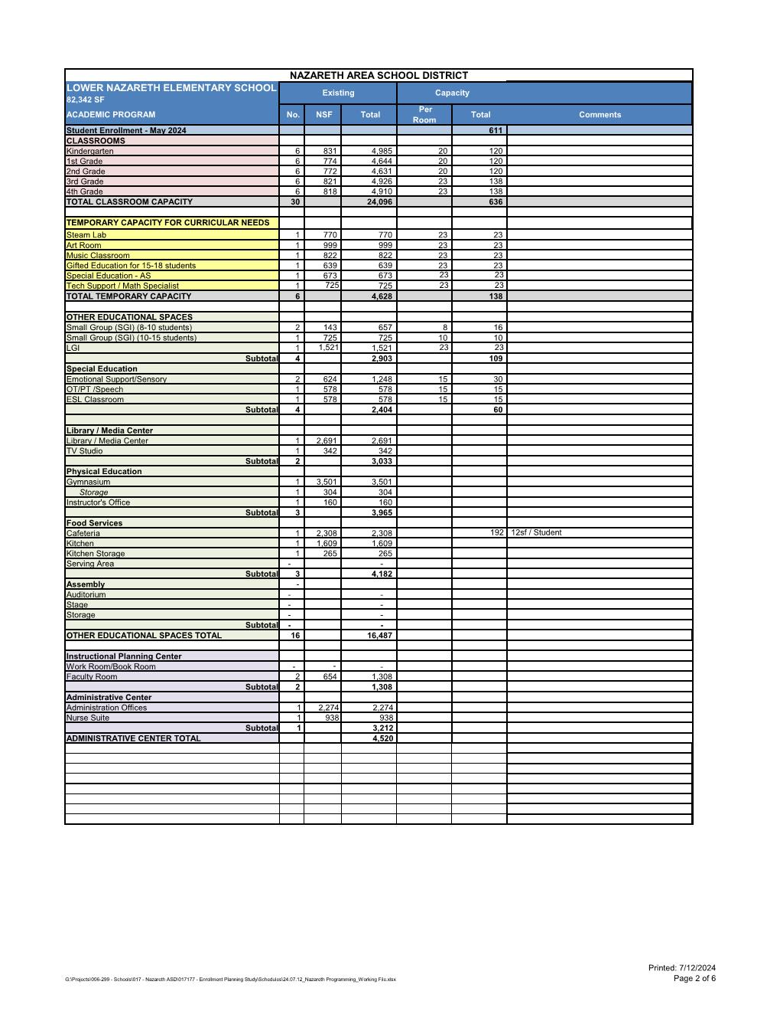
Elementary School Program – Lower Nazareth

Slide 12
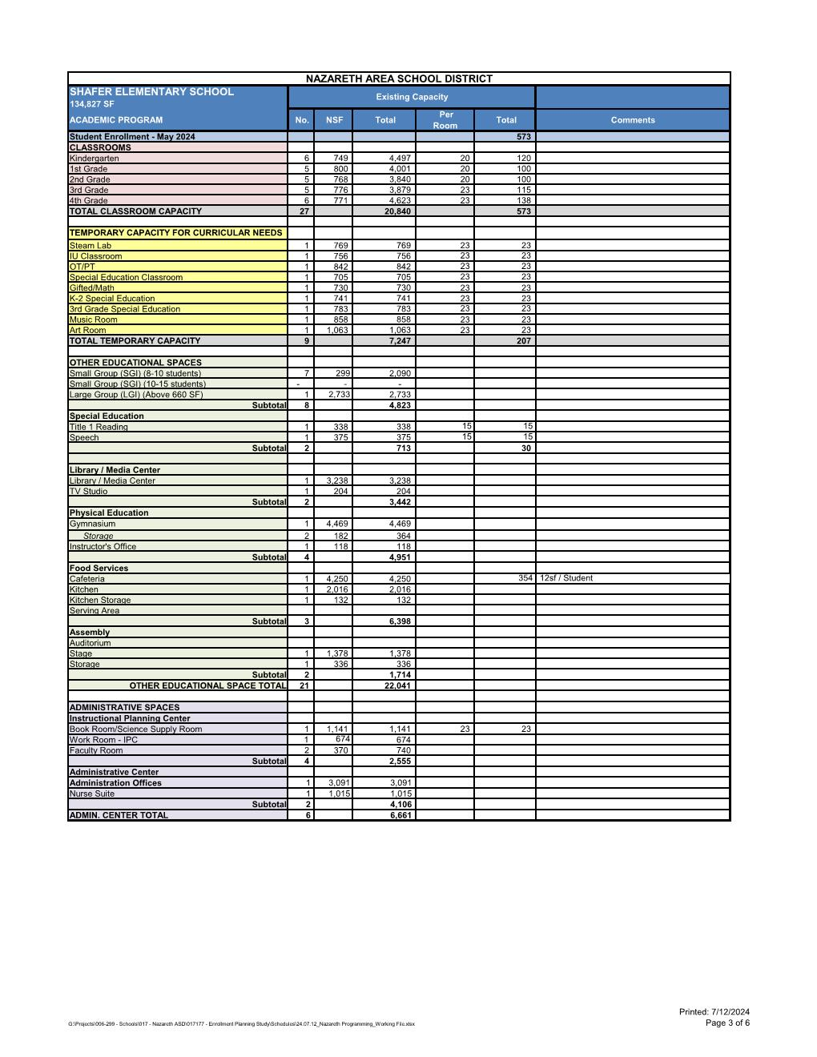
Elementary School Program – Floyd R. Shafer

Slide 13
Residential Development Research Report
Prepared by PowerSchool
Included information on “approved” development within the school district provided by the Municipalities.
Does NOT include planned development that has not been approved by the Municipalities.
To account for future, not yet approved development, the Integration Team is calculating the numbers provided by PowerSchool to be 80% of the future growth.

Slide 14
Residential Development Research Report
RESEARCH METHODOLOGY:
The residential research team works with the School District's local planning department(s) to compile a list of all active residential development projects within the District. When putting together this list of projects, we include only active, non-senior residential projects larger than 10 units. We believe this to be the most efficient way to build a picture of the District's future residential changes, since smaller projects would generally have a negligible impact on the District. These active projects would include developments either currently under construction, those with active entitlements, or any proposed future projects.
We then follow up with developers to gather as much information as possible on the project's unit type(s), planned build-out unit counts, construction schedules, etc. From these data, we create two scenarios. The Moderate DU Scenario is directly based on information provided by the planning departments and developers regarding anticipated construction schedules and unit occupancies. The Conservative DU Scenario is derived from the Moderate's by assuming occupancies will occur over a longer period. Because of this, the unit totals in the Conservative DU Scenario may be less than those of the Moderate DU Scenario if they are pushed out beyond the next 10 years. Similarly, because of these adjustments, in any given year it may also be possible for the annual number totals of the Conservative DU Scenario to exceed those of the Moderate DU Scenario.
DWELLING UNIT TYPES:
New dwelling units are categorized into the following three (3) housing types:
Single Family Detached ("SFD") – Units are stand-alone structures on their own lot with a unique Assessor's parcel number.
Single Family Attached ("SFA") – Units share common walls, usually on both sides of the property, where each is assigned a unique Assessor's parcel number (e.g., townhomes, condominiums, duplexes).
Multifamily ("MF") – Units share common walls in a building or structure designed to house several families in separate housing units. All units are on the same lot with one Assessor's parcel number (e.g., apartments).

Slide 15
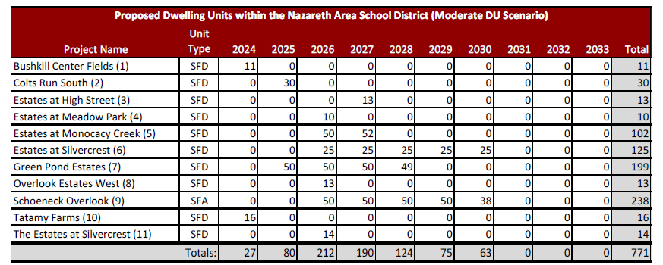
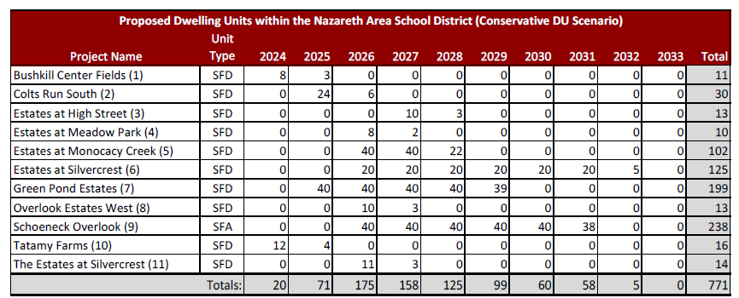
Residential Development Research Report
The two tables below provide the project name, unit type, and anticipated occupancy data for all active, non-senior residential development projects greater than 10 units planned to be occupied over the next 10 years.
Table 1 shows the Moderate DU Scenario.
Table 2 shows the Conservative DU Scenario.
The information in the tables is directly based on information provided by the planning departments and developers regarding anticipated construction schedules and unit occupancies.
TABLE - 1
TABLE - 2

Slide 16
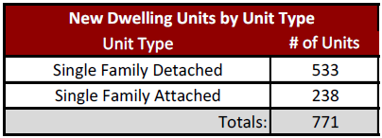
Residential Development Research Report
ACTIVE RESIDENTIAL DEVELOPMENT PROJECTS WITHIN THE DISTRICT
Based on information collected from the local planning department(s) and developer(s) as of 4/10/2024, it is anticipated that the district could potentially experience the construction and occupation of 771 new dwelling units over the next 10 years. The total unit count included in the Moderate DU Scenario is broken out as shown in the table below.

Slide 17
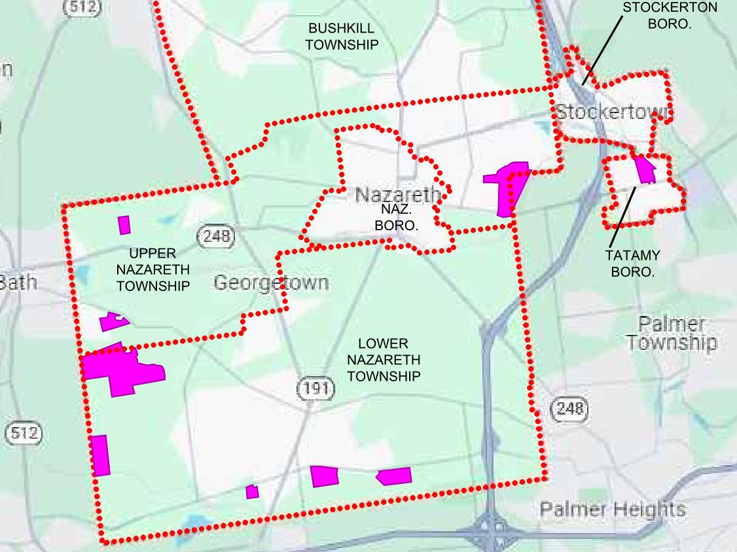
Residential Development Map

Slide 18
Other District Enrollment Factors
Other Factors that could impact District Enrollment
Unsubmitted or not Approved Developments (Approximately 1,150 acres has the potential for Residential Development).
Current Housing Stock Aging (turn-over to younger families).
Students enrolled in outside Cyber Schools: Approximately 140 Students
Home Schooled & Private Tutoring Students: 79 Students
Private/Non-Public/Charter Schools: 353 Students
Pennsylvania Education Policy Changes potential impact on programs.
The Integration Team has included an additional 20% to the enrollment figures provided by PowerSchool due to the other factors mentioned above and to allow for flexibility, planning, and space for enrollment or educational program growth. The Team believes this provides the best model for the Nazareth Area School District with planning for the next 25-years.

Slide 19
Elementary Schools Enrollment

Slide 20
Elementary School Enrollment Summary

Slide 21
Summary
The Goal of this Study is to assist the School Board, Administration, and Public to make the best decisions for the Current and Future Students of the Nazareth Area School District at the Classroom Level.
Development growth is planned in the Lower Nazareth and Upper Nazareth Municipalities.
District’s Desire to maintain existing grade configuration.
Elementary Schools are currently at or near capacity now.
Existing Elementary Schools have limited space for expansion. Utilities will need to be evaluated.
Review Enrollment Options for Future Planning.

Slide 22
Elementary School Enrollment Options
There is Temporary Capacity within each building that allows the School District to look at the long-term options
Option 1: Construct Building Addition(s) and Renovate Existing Buildings as Required (Existing utilities must be verified).
Option 2: Construct new Elementary School in Area of District where growth is occurring.

Slide 23
Next Steps
Elementary School Needs:
Option 1: Consider Expansion at Elementary Schools
Option 2: Consider Construction of new Elementary School
Board provide Direction to Integration Team on Options 1 & 2
Provide Recommendation to Board on Property Purchase.
Develop Budget Estimates for Selected Option.
Develop the Financial Plan.
Return to the Board for an Update.

Slide 24
Thank You!
Questions???

